Slide 1
MICRO CREDIT LOAN DEFAULTER
PROJECT TITLE
PREPARED BY:
IFATH FATIMA

Slide 2
INTRODUCTION
A Microfinance Institution (MFI) is an organization that offers financial services to low income populations. Microfinance services (MFS) becomes very useful when targeting especially the unbanked poor families living in remote areas with not much sources of income. The MFS provided by MFI are Group Loans, Agricultural Loans, and Individual Business Loans and so on.
Many microfinance institutions (MFI), experts and donors are supporting the idea of using mobile financial services (MFS) which they feel are more convenient and efficient, and cost saving, than the traditional high-touch model used since long for the purpose of delivering microfinance services. Though, the MFI industry is primarily focusing on low income families and are very useful in such areas, the implementation of MFS has been uneven with both significant challenges and successes.
They understand the importance of communication and how it affects a person’s life, thus focusing on providing their services and products to low income families and poor customers that can help them in the need of hour. They are collaborating with an MFI to provide micro-credit on mobile balances to be paid back in some days.

Slide 3
PROBLEM STATEMENT
MFI to provide micro-credit on mobile balances to be paid back in 5 days. The Consumer is believed to be defaulter if he deviates from the path of paying back the loaned amount within the time duration of 5 days. For the loan amount of 5 (in Indonesian Rupiah), payback amount should be 6 (in Indonesian Rupiah), while, for the loan amount of 10 (in Indonesian Rupiah), the payback amount should be 12 (in Indonesian Rupiah).
The sample data is provided to us from our client database. It is hereby given to you for this exercise. In order to improve the selection of customers for the credit, the client wants some predictions that could help them in further investment and improvement in selection of customers.
Build a model which can be used to predict in terms of a probability for each loan transaction, whether the customer will be paying back the loaned amount within 5 days of insurance of loan. In this case, Label ‘1’ indicates that the loan has been payed i.e. Non- defaulter, while, Label ‘0’ indicates that the loan has not been payed i.e. defaulter.

Slide 4
LIFE CYCLE OF ML BEGINS
DATA CLEANSING AND WRANGLING
First we check the information of the given dataset because it tells that how many rows and columns are present in our dataset and data type of the columns whether they are object, integer or float.
Drop duplicates rows if present in dataset.Then we check for the null values present in our dataset.
If null values are present then fill it via mean, median or mode. Or also you can remove that rows but kindly check it properly.After that we check the summary statistics of our dataset. This part tells about the statistics of our dataset i.e. mean, median, max value ,min values and also it tell whether outliers are present in our dataset or not. We also check the correlation of our dataset to check the correlation of the columns with each other. If columns are highly correlated with each other let’s say 90% or above then remove those columns to avoid multi collinearity problem.
We cannot remove outliers because more than 20% of our data are removed.

Slide 5
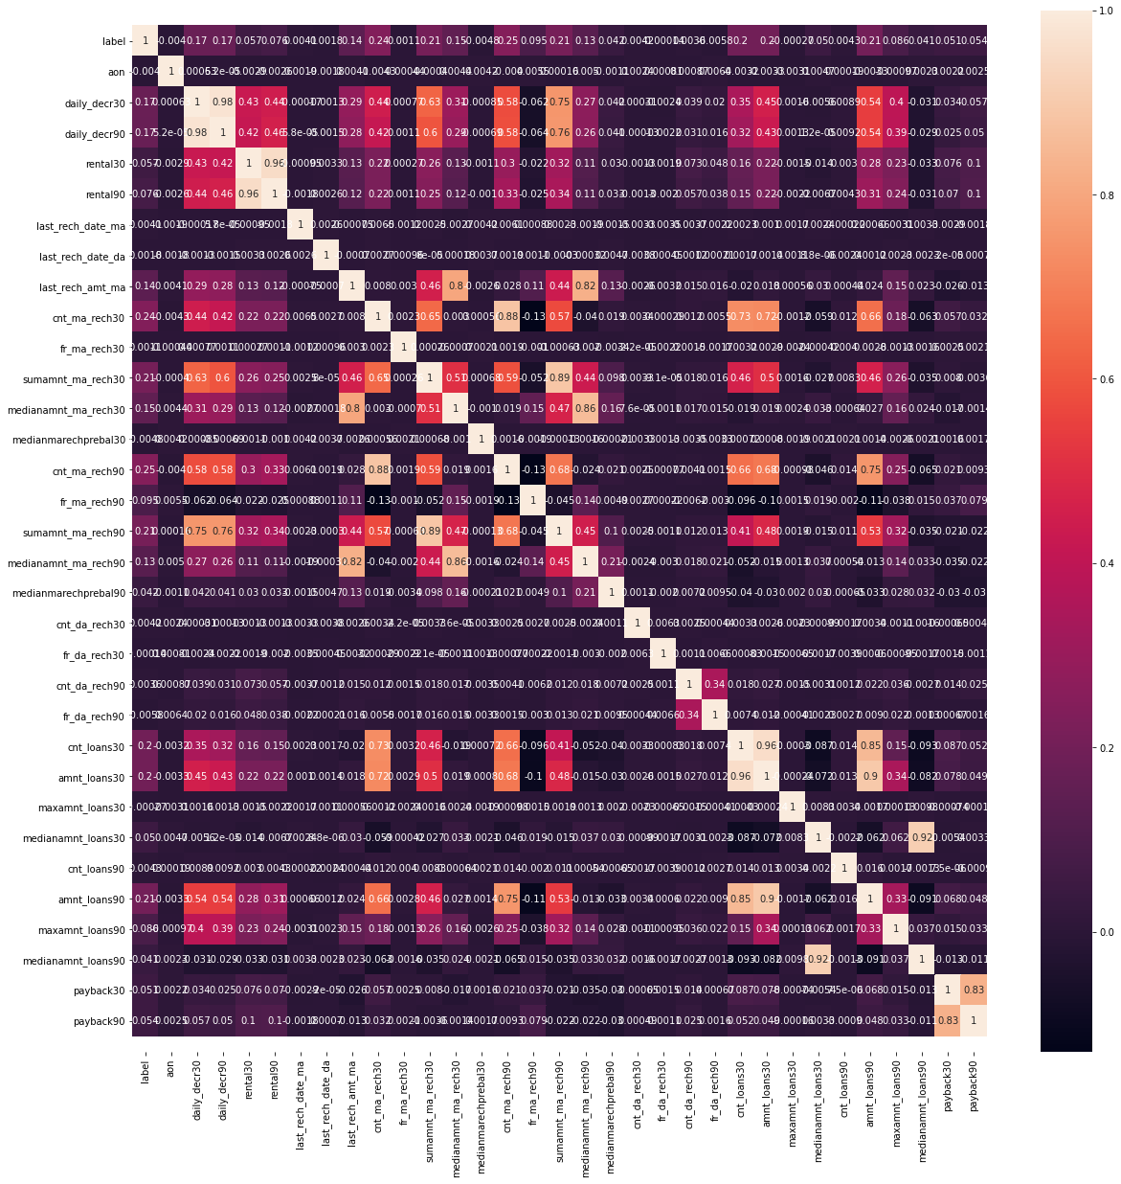
Correlation Heatmap

Slide 6
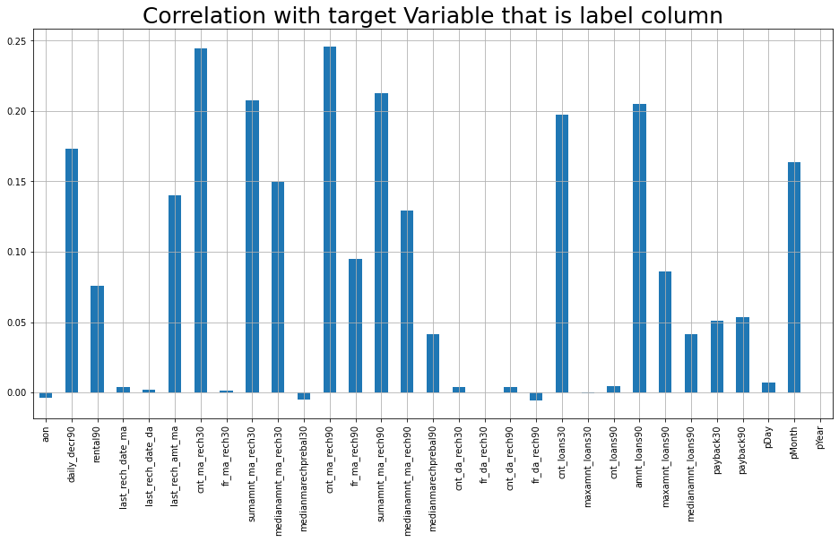
DATA VISUALIZATION

Slide 7
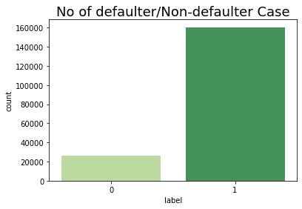
1 160383
0 25860
Name: label, dtype: int64

Slide 8
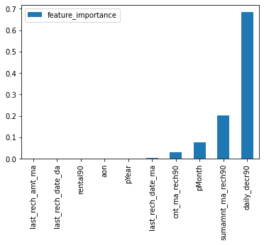
DecisionTreeClassifier(max_depth=3)
We can see at daily_decr90 which is Daily amount spent from main account, averaged over last 90 days (in Indonesian Rupiah), it seems that this feature helps to discriminate the data indeed. This feature can bring insights for company when analyzing a customers.

Slide 9
Data Modeling
We use the following Machine learning algorithms and built Classification models for our supervised classification task.
LogisticRegression
DecisionTreeClassifier
RandomForestClassifier
KNeighborsClassifier
GaussianNB
Model Evaluation
Evaluated Classification models by Accuracy, Confusion Matrix, Precision, Recall, F1-score,ROC – AUC chart.

Slide 10
Result:
 | Model | Accuracy_score | Cross_val_score | Roc_auc_curve
0 | LogisticRegression | 61.362721 | 86.423650 | 71.720115
1 | DecisionTreeClassifier | 61.362721 | 87.465835 | 71.720115
2 | RandomForestClassifier | 61.362721 | 91.326384 | 71.720115
3 | KNeighborsClassifier | 61.362721 | 87.139379 | 71.720115
4 | GaussianNB | 61.362721 | 60.837705 | 71.720115

Slide 11
Conclusion:
According to the performance metrics, Random Forrest scores highest in accuracy.
Hence, Random Forrest looks like the best fit for this data.

Slide 12
THANK YOU

